Slide 1


IT516 GD03 TWITTER PRESENTATION
PHIL, AARON, TED, YOUNG

Slide 2
AGENDA
Data Extraction
R
Python
Regular Expression (Regex)
Data Import
Processing
Storage
Data Statistic
StdDraw
Data Visualization

Slide 3
Twitter Data
Originally considered sample data from Kaggle
Tried Spring Social Twitter and Twitter4J (Java)
Extracted Twitter Data via R packages
twitterR
rtweet
R configuration used for both twitterR & rtweet
Twitter Developer account required
Keys: API, API Secret, Token, and Token Secret
Retrieve tweets contain the string “squid game”
“squid game”
Notes:
Originally, we wanted to use a data source from Kaggle but was informed that the data must be retrieved by us
Tried Spring Social Twitter from the Twitter REST API but I wasn’t able to get it to work - related to dependencies of the org.codehaus.jackson framework being unavailable
Then tried Twitter4J (v4.0.7), which is an open-source API for Java but I wasn’t satisfied with the results so I transitioned to R because there wasn’t a requirement to use Java to retrieve tweets
required MAVEN dependencies
limited to 100 tweets at a time and code to increase limit didn’t work all the time
last updated 2016
Searched for “squid game” in content of tweet and not just #SquidGame

Slide 4
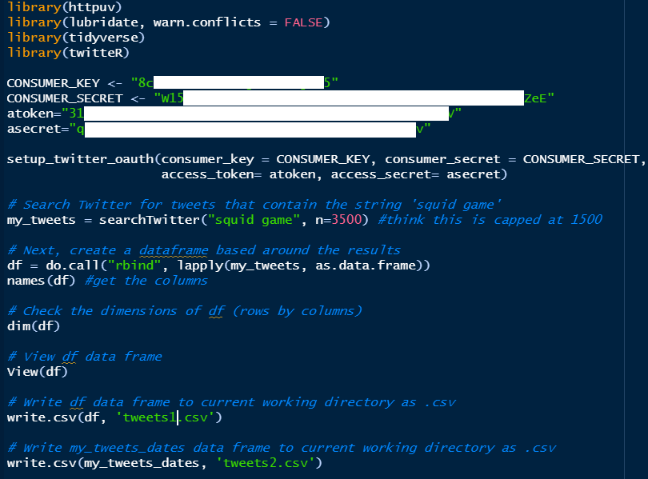
twitterR Configuration
Limited to 3500 tweets per cycle
Extract from recent 6 days
February 12 to 19
Limited to default 16 fields
Notes:
First I used twitterR package but it has limitations, e.g. number of tweets retrieved per cycle (3500 max); goes back 6 days only and since it runs once per cycle duplicates could be captured; default 16 fields; 23 functions
API authentication is via the console
Original R code, using twitterR package, was insufficient as it:
would pull the same data as initial pull when ran at different times of the day
included 16 fields, of which 5 were always blank
search results limited to:
~1300 retrieved tweets per 24 hour period
looks back up to six (6) days
23 available functions within twitterR package
resulted in obtaining needed total size of tweets
was determined the following were removed during pre-procesing:
@ and # symbols
http and https references

Slide 5

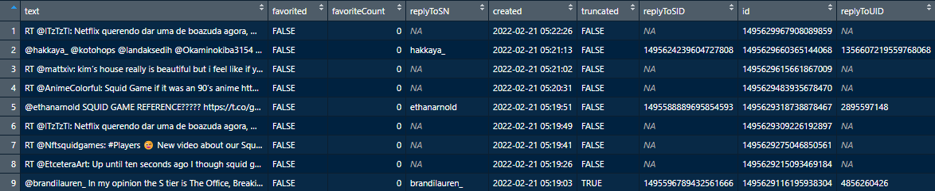
twitterR Results
3,500 rows by 16 fields
Retrieved tweets

Slide 6
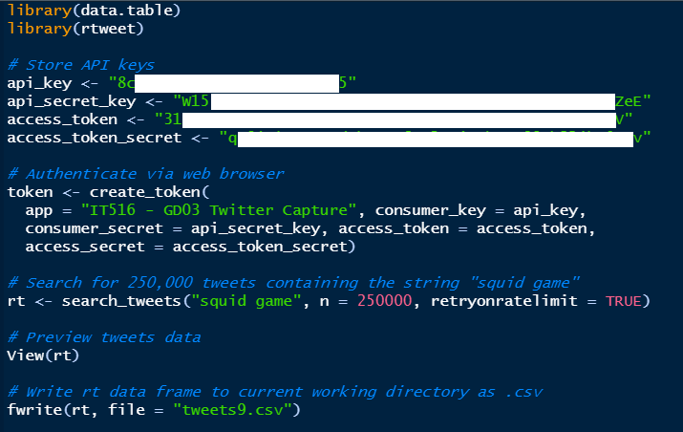
rtweet Configuration
Limit increased to 250K tweets per cycle
Extract from recent 14 days
February 5 to 19
90 fields by default
Notes:
rtweet is a newer R package that increases number of tweets retrieved per cycle to 250K; goes back 14 days only; default 90 fields; 63 functions
API authentication is via web browser
Secondary R code, using rtweets package, proved better:
multiple pulls resulted in different tweet retrieval
included 90 fields, 13 of which were always blank (a 462.5% increase of potentially accessible data over twitterR package)
search results limited to:
up to 250K retrieved tweets per run
looks back up to 14 days (a 133.3% increase of potentially accessible data over twitterR package)
63 available functions within rtweets package (a 173.9% increase of potentially accessible data over twitterR package)
resulted in obtaining more than needed size of tweets
was determined the following were retained during pre-processing:
@ and # symbols
http and https references

Slide 7
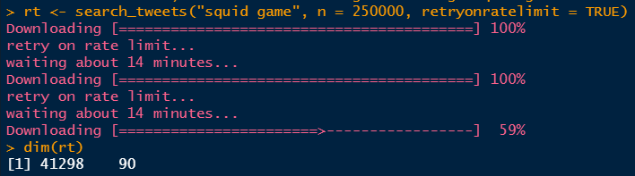
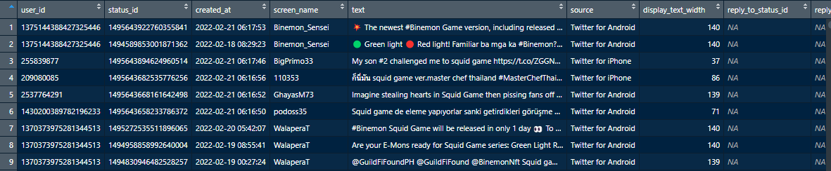
rtweet Package
41,298 rows by 90 fields
Retrieved tweets

Slide 8

Twitter Data Extraction through Python

Slide 9
Twitter Data
12 Variables
User_created
Tweet text created date and time
Tweet_text
Tweet text content
Username
All_hastags
Followers_count
Location
Description
Timestamp
User profile created time and date
User_friends
User_favorite
Retweet_count
Source
#SquidGame

Slide 10
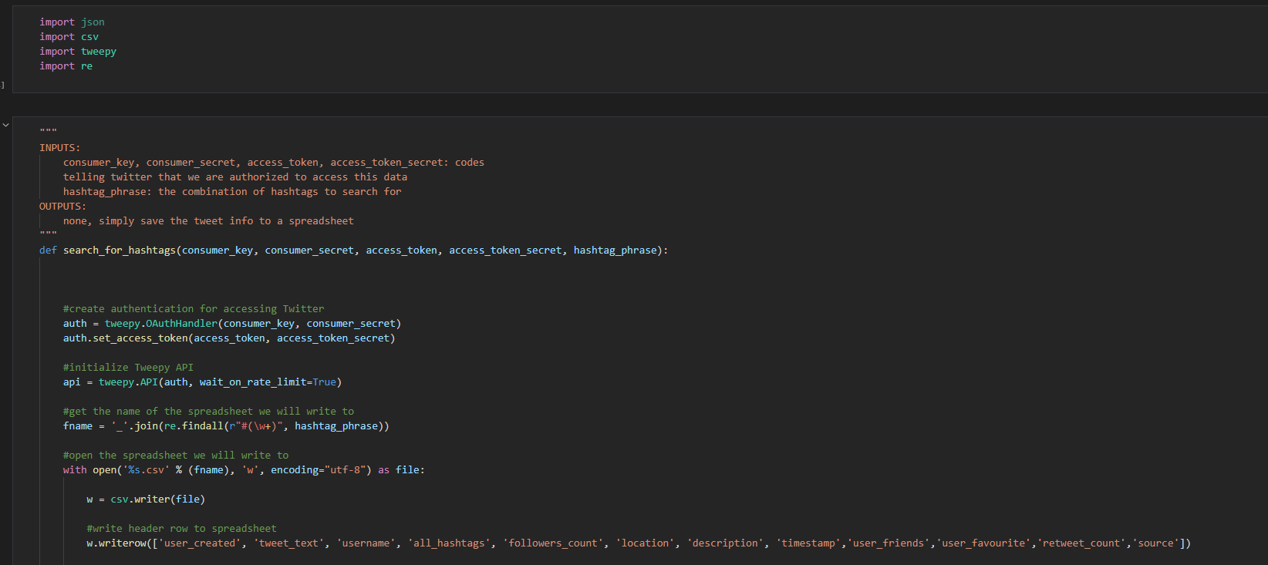
Twitter Data
Search for hashtag #squidgame in Twitter data
12 variables shown in the last line
“squid game”

Slide 11
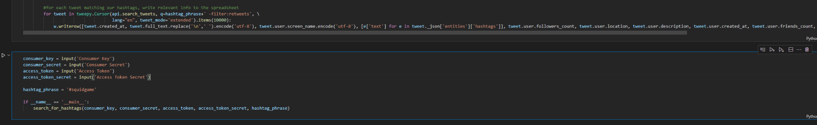
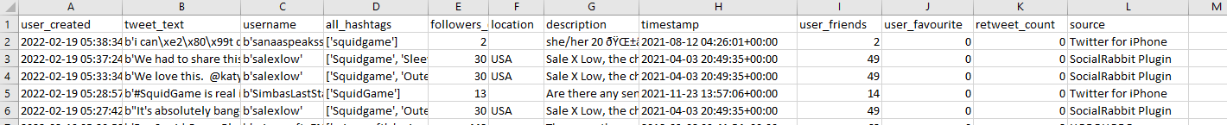
Twitter Data
Search for hashtag #squidgame in Twitter data
“squid game”

Slide 12
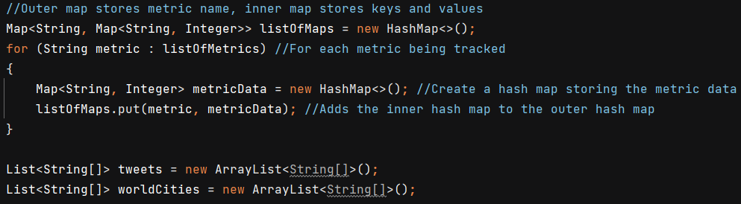
Data Import, Processing, and Storage
Creation of data structures: nested hash maps
Create an array of the names of metrics that will be referenced later
i.e. username, country, city, follower count, favorites
Outer hash map contains the name of the metric as the keys and inner hash maps as the values
Inner hash maps contain the value of the metric as the key and the number of occurrences as the value

Slide 13
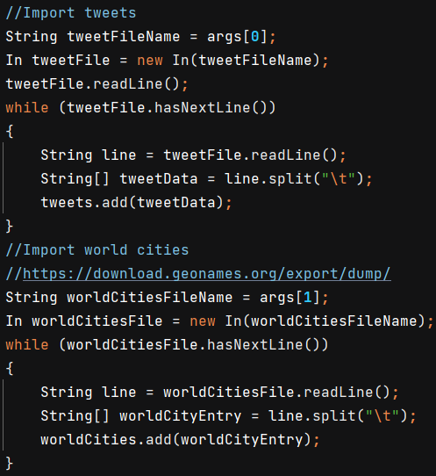
Data Import, Processing, and Storage
Data import:
First, we imported the raw Twitter data line-by-line into an ArrayList
Then, we mported a list of all cities in the world with population over 15,000 from GeoNames.org into an ArrayList
We assigned each column of the two sets of imported data into a sub-array within each ArrayList item

Slide 14
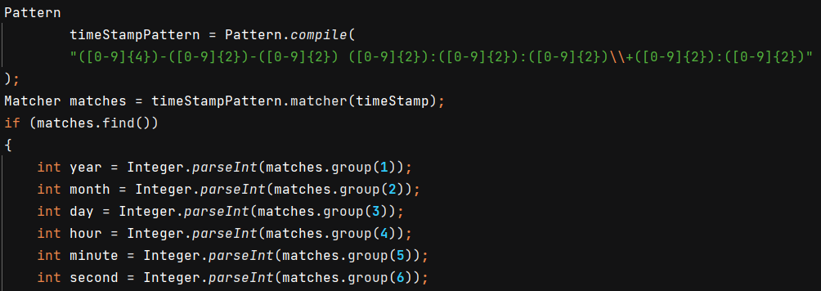
Data Import, Processing, and Storage
Data processing:
We used RegEx to extract data points from each column of the Twitter data
Points included Month, Day, Year, Hour, Minute, Second, hashtags, mentions, and more
Compared the tweet location field with the list of city names from GeoNames.org
Used the city name to guess at the country
Extracted @ mentions from the tweet text
Convert to lowercase where applicable

Slide 15
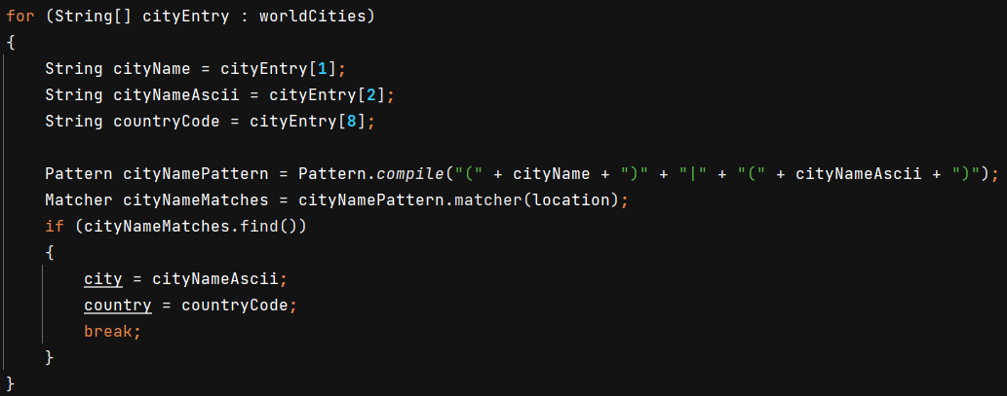
Data Import, Processing, and Storage

Slide 16
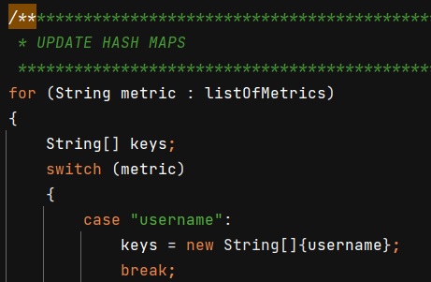
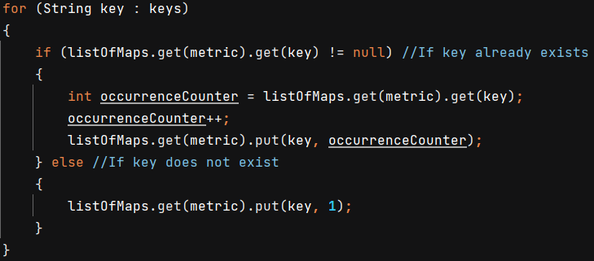
Data Import, Processing, and Storage
Post-processing storage:
After processing the input files, the tweet metric variables were populated and ready to be added to the hash maps
The inner hash map keys are read to determine if the metric already exists in the table. If it does, increment occurrence counter (value) by 1, otherwise set to 1.
Provides basis for statistics data and visualizations

Slide 17
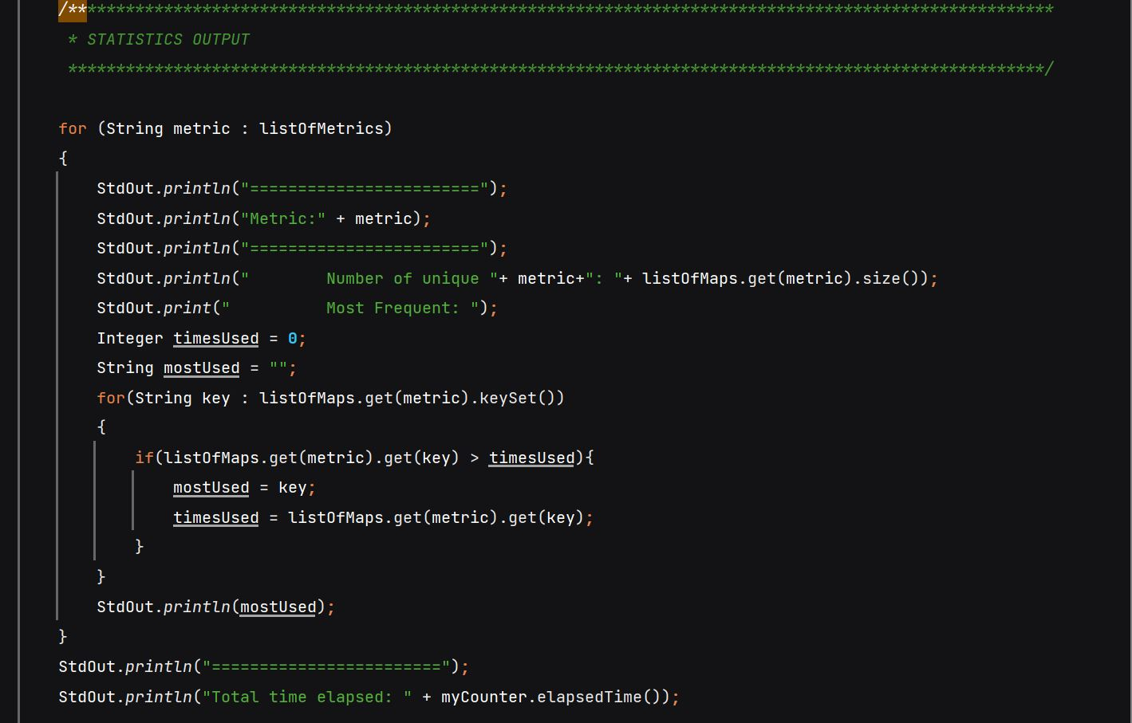
Twitter Data
Number of Uniques
Most Frequently Used Element
Time Elapsed
#SquidGame

Slide 18
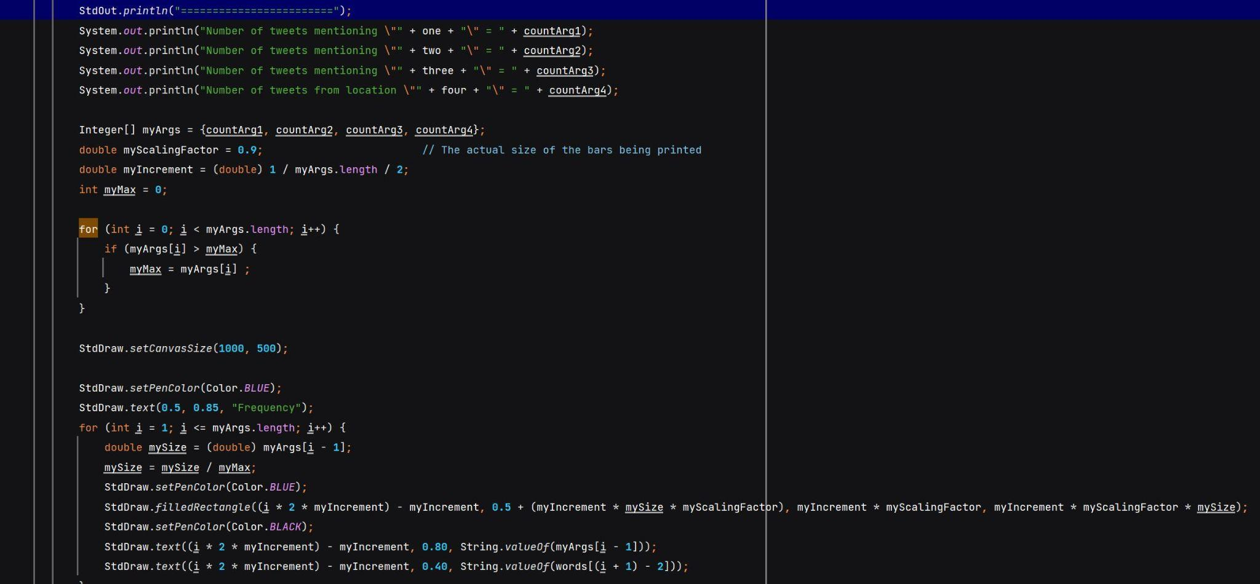
Twitter Data
Four User Inputed Elements
Displayed as a Bar Graph
#SquidGame

Slide 19
THANK YOU
Questions?

